Slide 1

EEE8097
IoT-Enabled Hand Gesture Detection with LEAP Motion
Shihao Zhou ID: 230594553 Supervisor: Matthew Dyson

Slide 2

1
Motivation and Objectives
2
Technologies and Methods
3
Challenges and solutions
4
Experiment and Analysis
5
Project Demonstration

Slide 3

01
PART ONE
Motivation and Objectives
Shihao Zhou ID: 230594553

Slide 4
Motivation and Objectives
Motivation：
To improve the quality of life of prosthesis users. Try tracking how a prosthetic hand is used in real life. Use the LEAP Motion Controller to point at a hand, be able to say what the grip state of that hand is, and test at which angles and viewpoints the device works well.
Objectives:
Survey literature on activity monitoring of artificial hands.
Obtain a measure of finger position from LEAP sensor and record it as a time series.
Log the detected grasp and finger position data to an IoT dashboard.
Send commands to the prosthetic hand from the IoT dashboard.
Make a portable version of the system.

Slide 5
PART TWO
02
Technologies and Methods
Shihao Zhou ID: 230594553

Slide 6
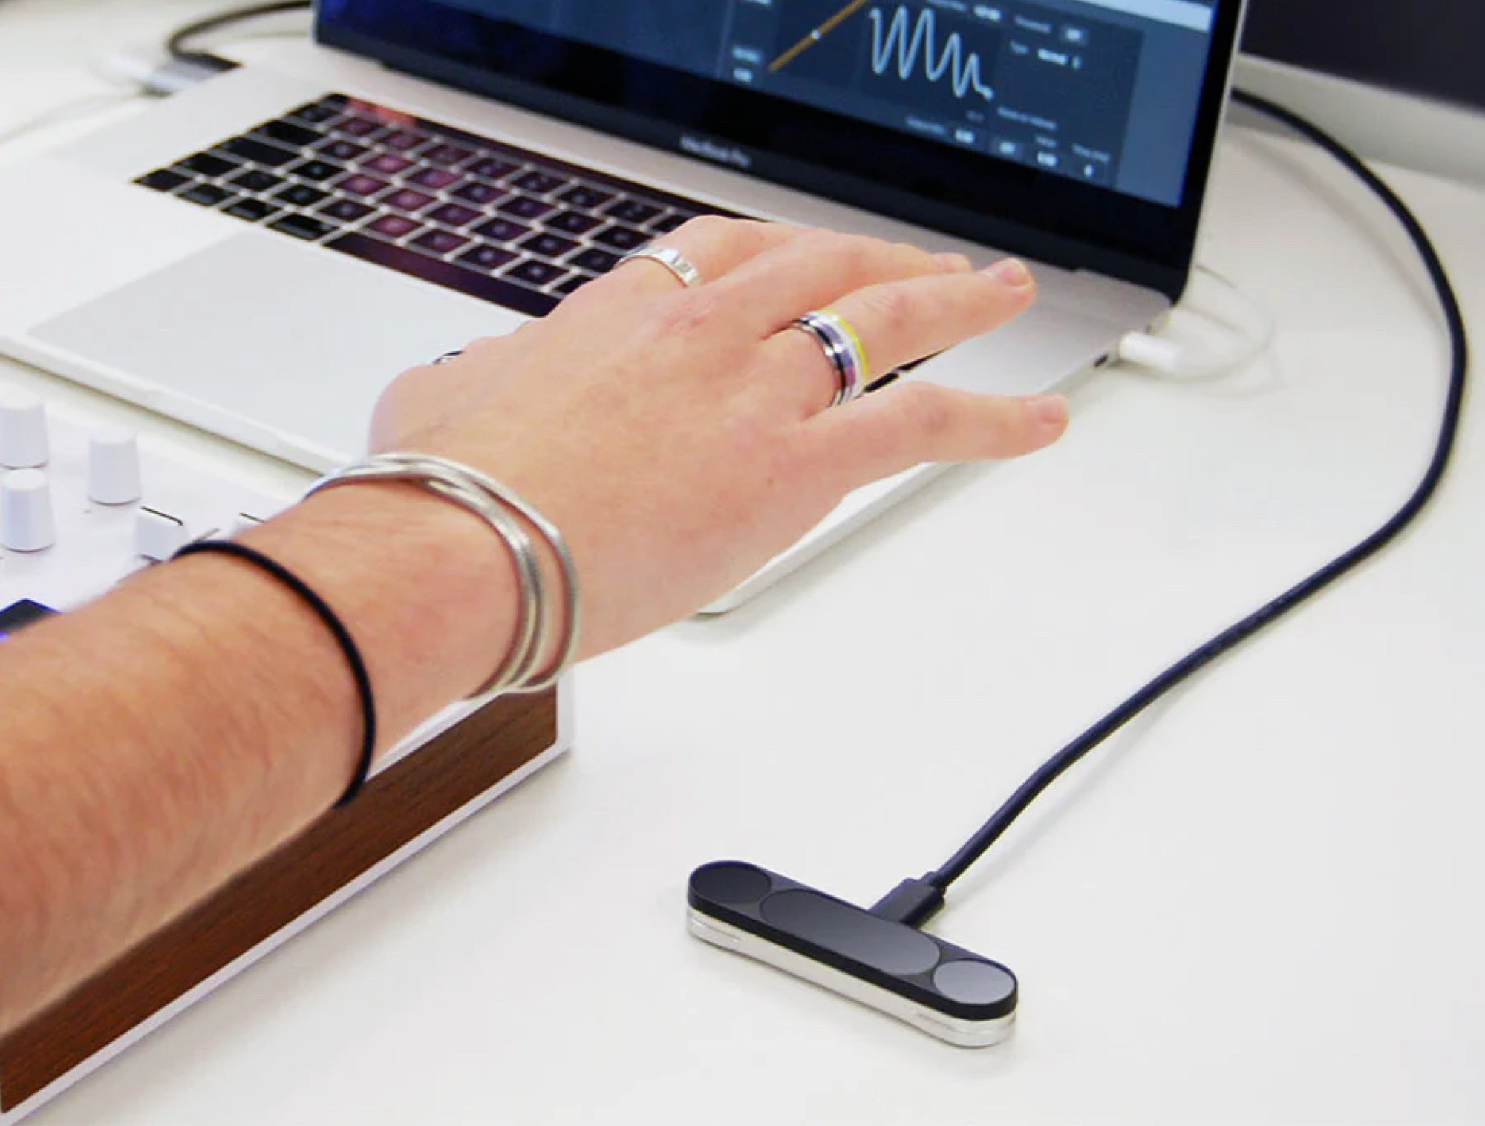
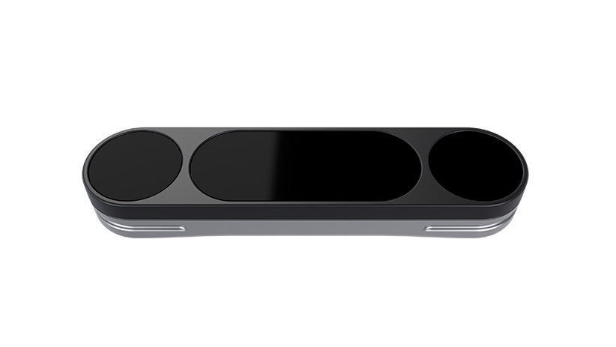
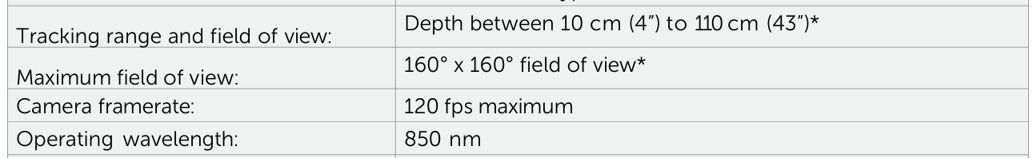
Technologies and Methods
Leap Motion Controller 2
The Leap Motion Controller 2 from Ultraleap is an optical hand tracking module that captures the movement of users’ hands and fingers so they can interact naturally with digital content.
The controller is capable of tracking hands within a 3D interactive zone . When combined with Ultraleap‘s Gemini hand tracking software, the Leap Motion Controller 2 is able to discern 27 distinct hand elements, including bones and joints, and visualise them even when they are obscured by other parts of the hand.
It supports three different tracking orientation modes:
Desktop (facing up from a table).
Head–mounted (fastened to a VR/AR headset).
Screentop (facing down towards the user).

Slide 7
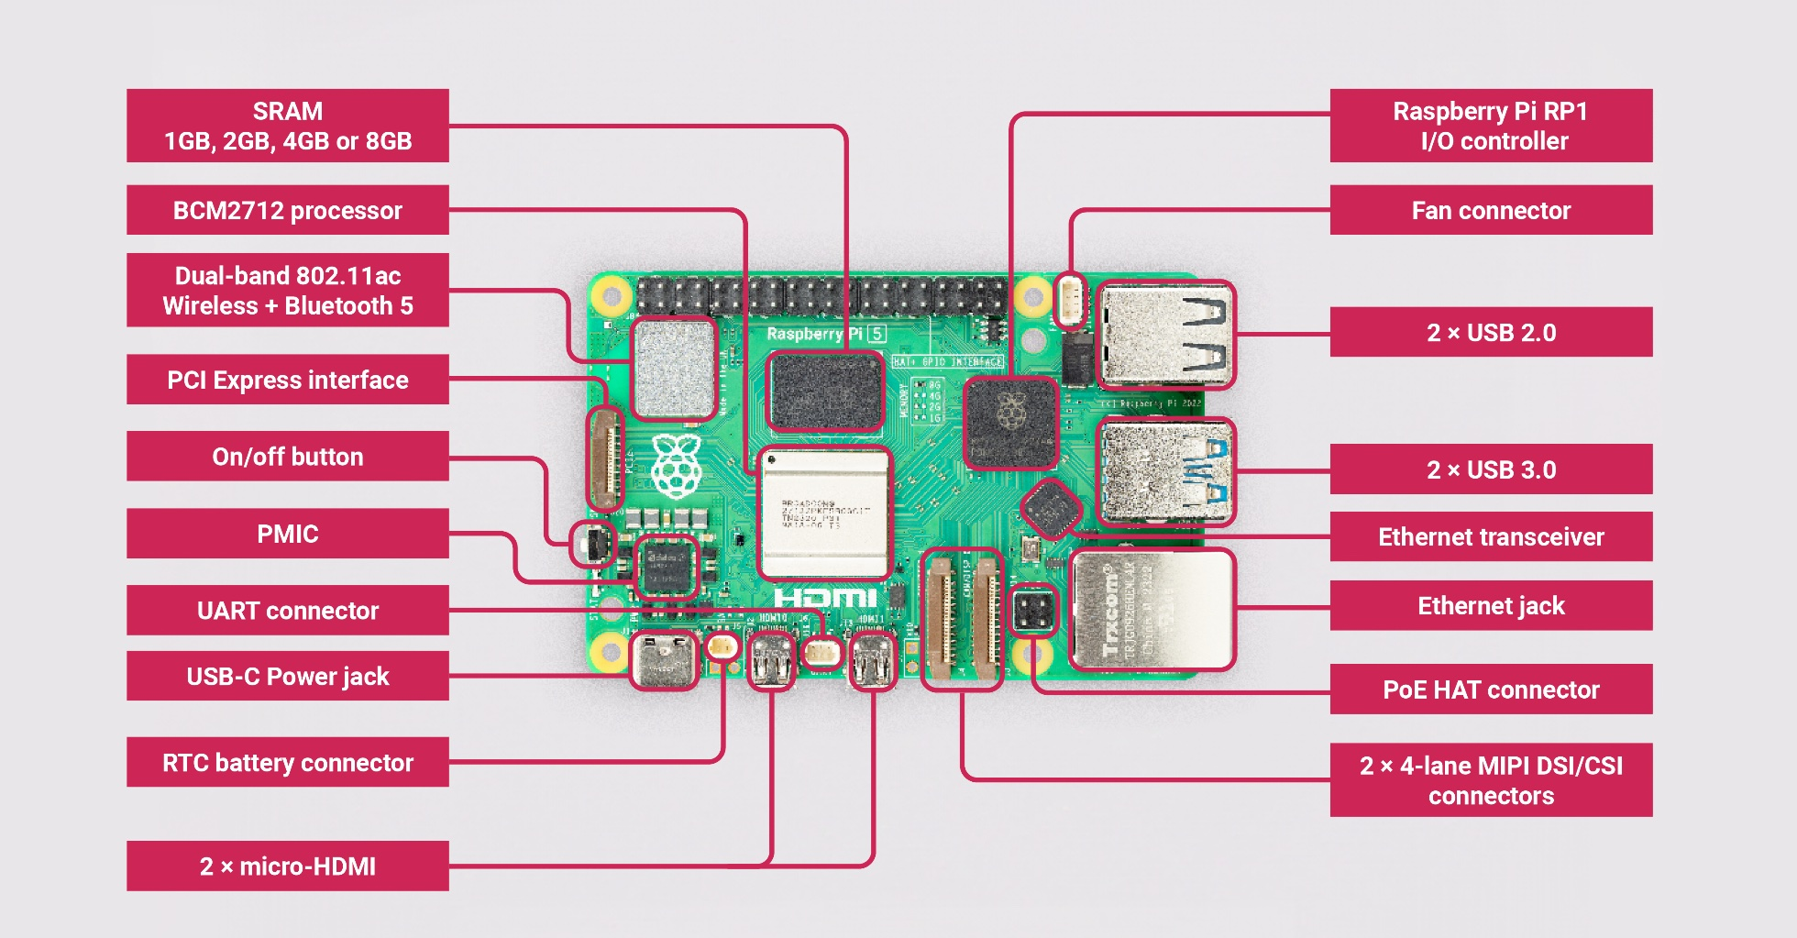
Technologies and Methods
Raspberry Pi 5
The Raspberry Pi 5 is powered by a 64-bit quad-core Arm Cortex-A76 processor running at 2.4GHz, which provides a 2 to 3 times increase in CPU performance compared to the Raspberry Pi 4. In addition graphics performance is also significantly improved over the 800MHz VideoCore VII GPU; with dual 4Kp60 display outputs via HDMI; and state-of-the-art camera support provided by the redesigned architecture of the Raspberry Pi Image Signal Processor, it provides a smooth desktop experience for consumers and opens the door to new applications for industrial customers.

Slide 8
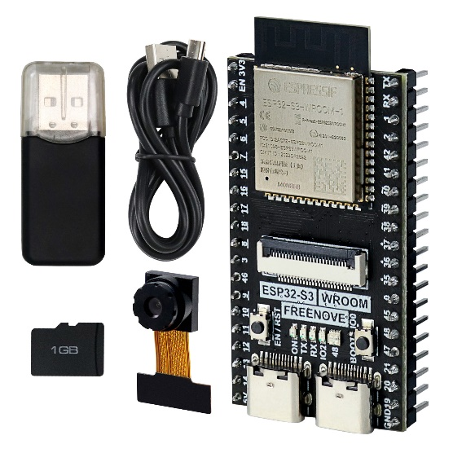
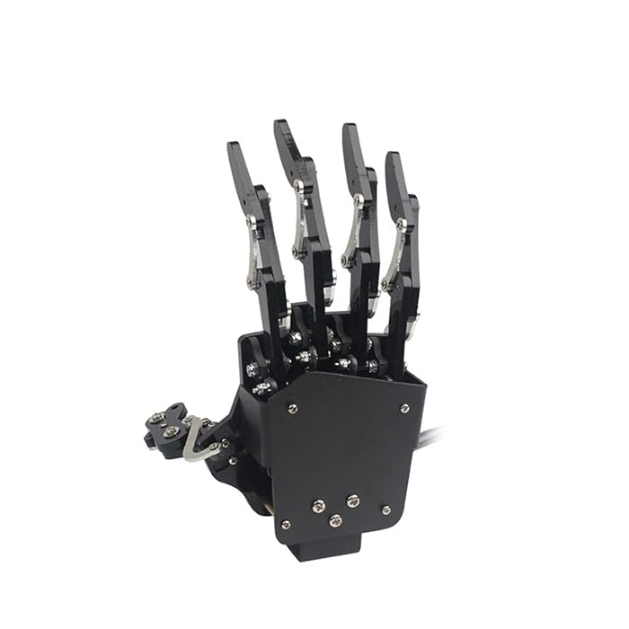
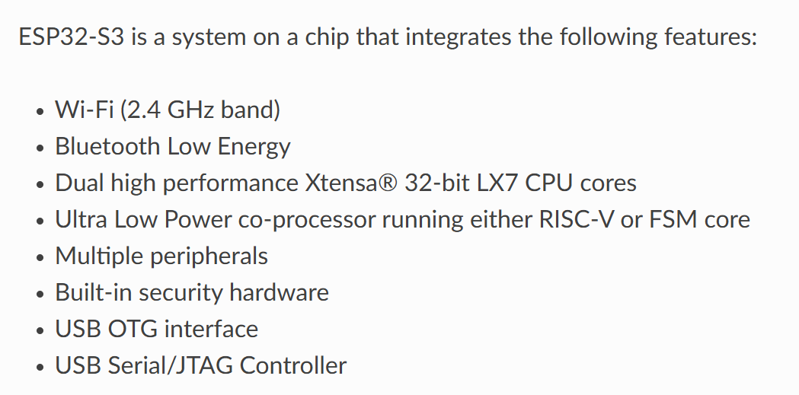
Technologies and Methods
ESP32 S3 & Robot Hand
ESP32-S3 is a System-on-Chip (SoC) MCU released by Espressif, integrating 2.4 GHz Wi-Fi and Bluetooth 5 (LE) capabilities, including Long Range support. It is equipped with a powerful Xtensa® 32-bit LX7 dual-core processor, clocked at up to 240 MHz, and features 512 KB of built-in SRAM (TCM). Additionally, the chip offers 45 programmable GPIO pins and a wide range of communication interfaces. ESP32-S3 also supports larger high-speed Octal SPI flash and external RAM, enabling users to configure data and instruction caching for improved performance.
Each finger of the hand is controlled by a servomotor.

Slide 9
03
PART Three
Challenges and Solutions
Shihao Zhou ID: 230594553

Slide 10
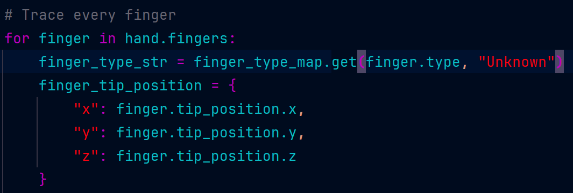
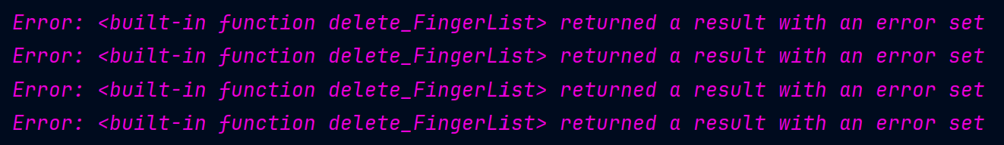
Challenges and Solutions
1
Fatal error of LEAP 1 SDK Code
Every time I try to use a for loop to trace through each finger, it reports an error
Solution:
Replace the controller with version 2.
Download new SDK Code from Ultraleap.

Slide 11
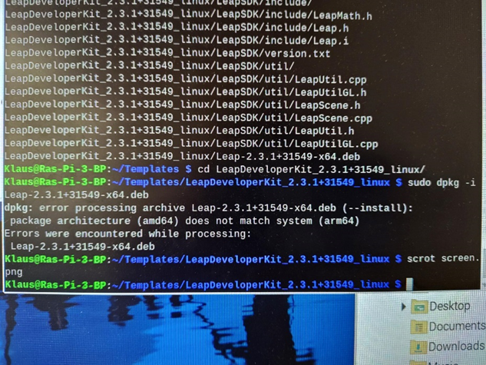
Challenges and Solutions
2
Different structures of CPU
Software for Leap motion 1 is only available for amd64 structure.
Solution:
Replace the controller with version 2.

Slide 12
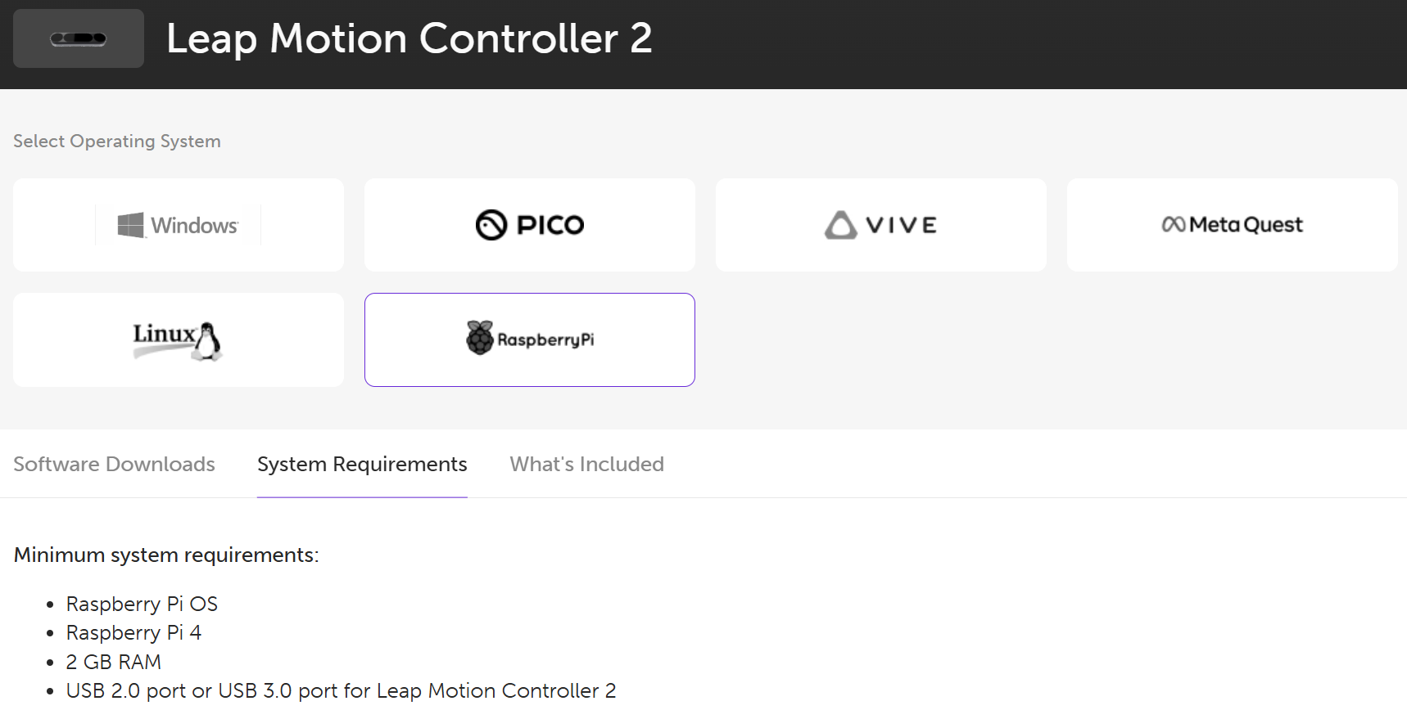
Challenges and Solutions
3
Uni only provides Raspberry Pi 3B+
According to the Ultraleap website, it requires at least a Raspberry Pi 4 or higher to run the software
Solution:
I bought a Raspberry Pi 5 for myself.

Slide 13
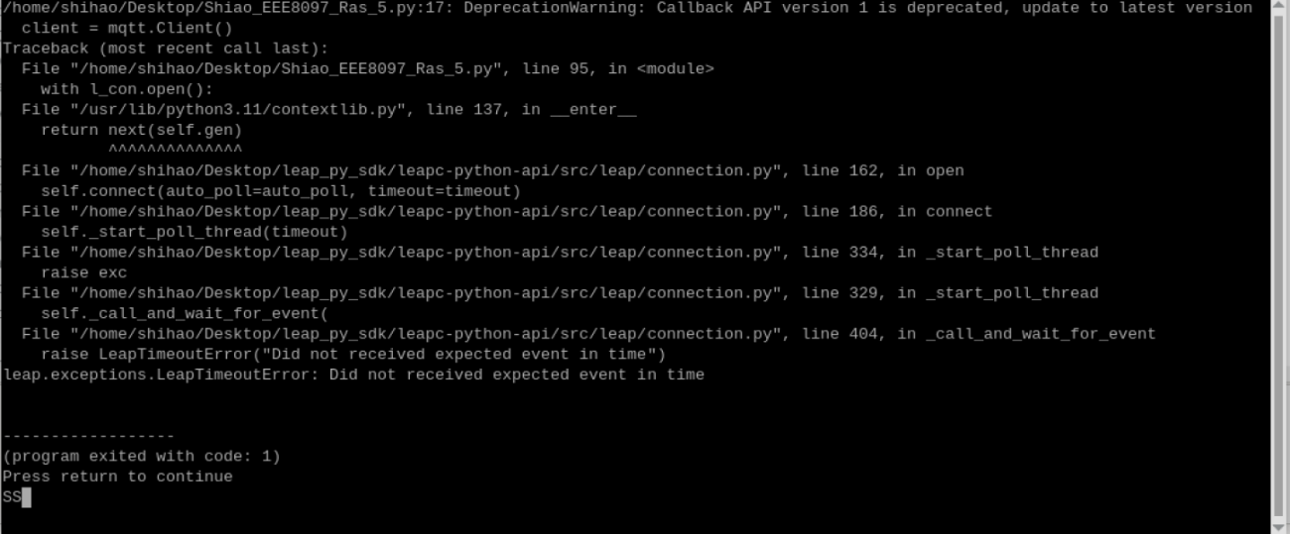
Challenges and Solutions
4
Raspberry Pi fails to start controller service after every reboot
Leap Motion Controller need Ultraleap Gemini Software.
Solution:
After each boot, enter the following code at the CMD: 代填写

Slide 14
04
PART Four
Experiment and Analysis
Shihao Zhou ID: 230594553

Slide 15
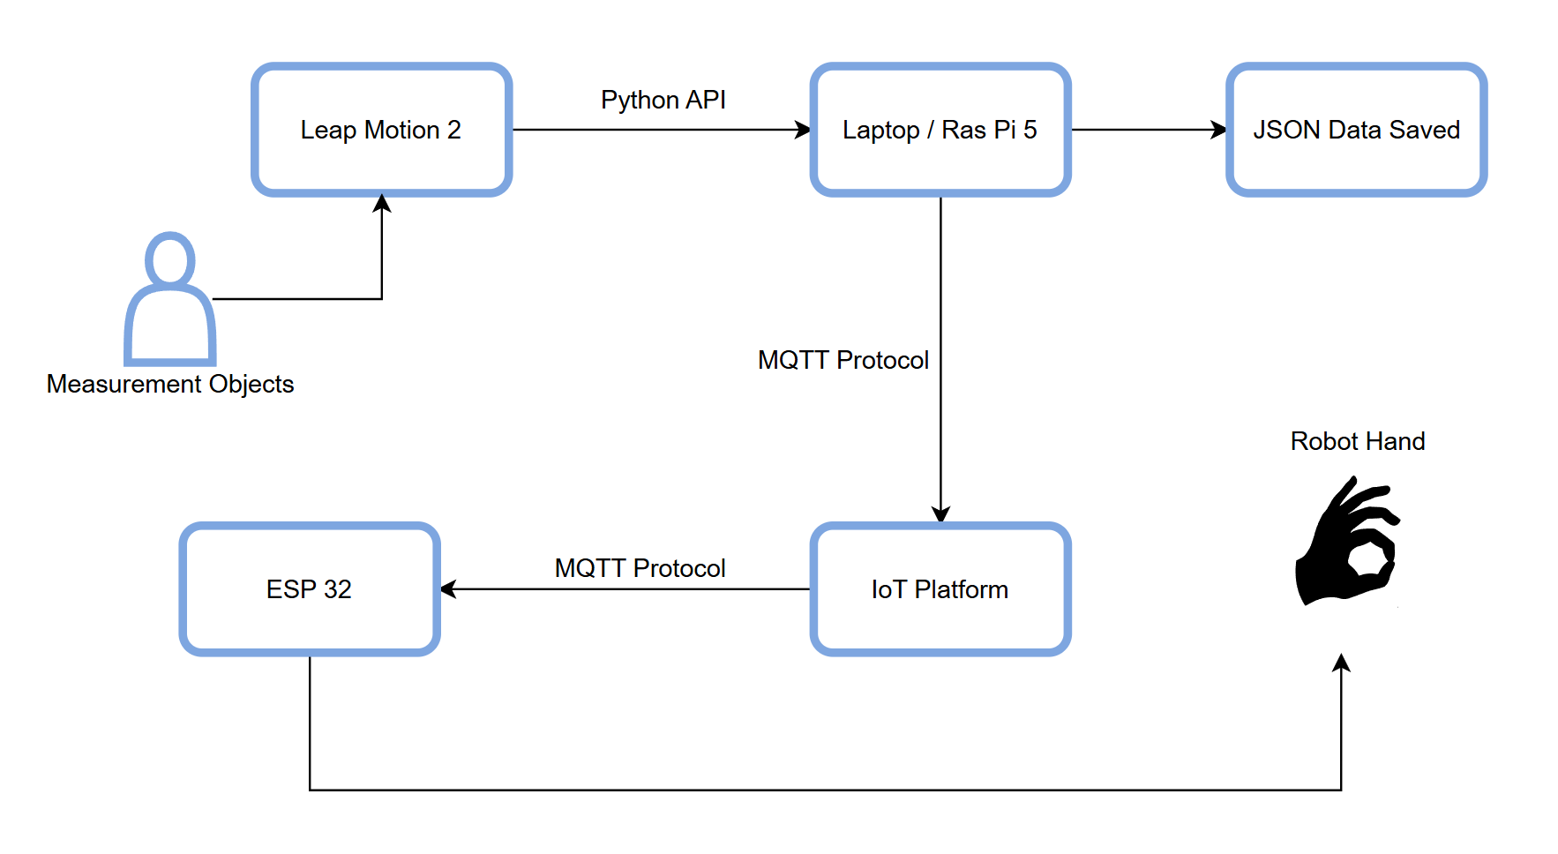
Experiment and Analysis
Workflow Chart

Slide 16
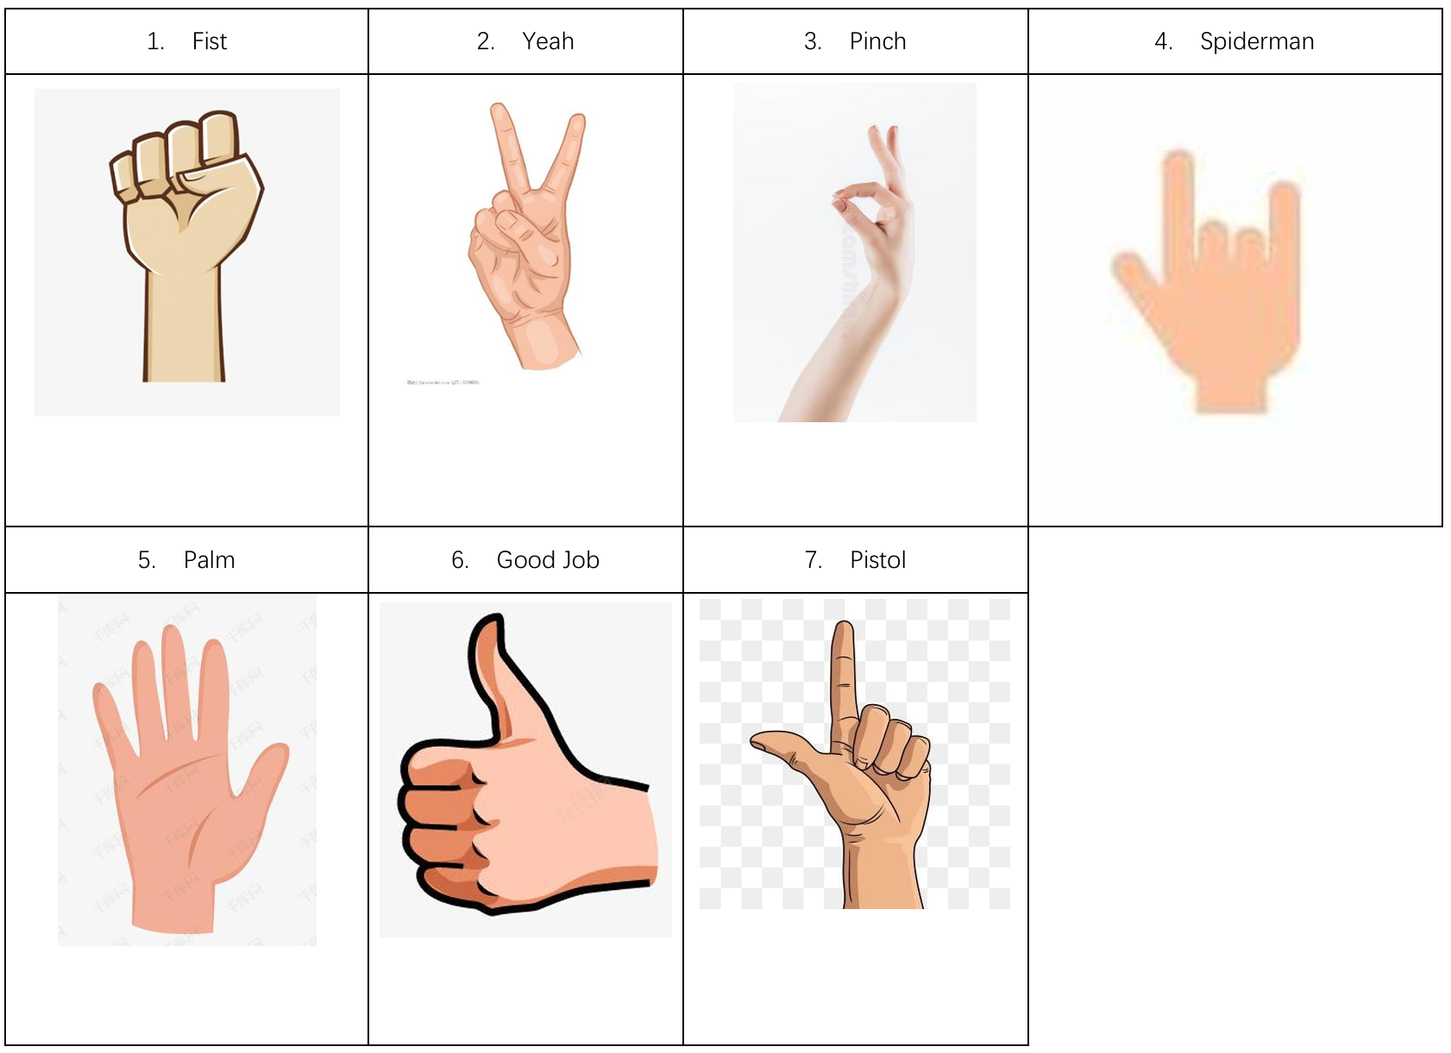
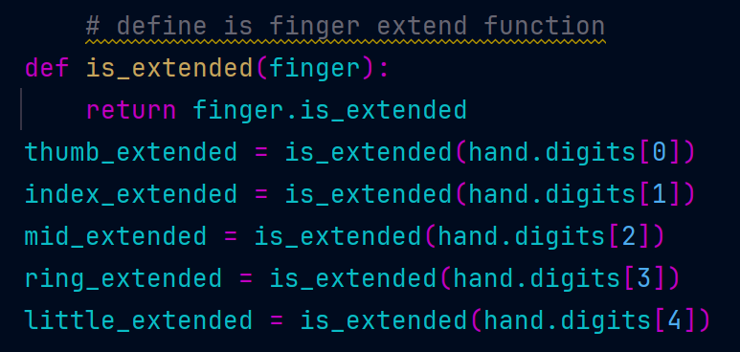
Experiment and Analysis
Hand Gestures

Slide 17
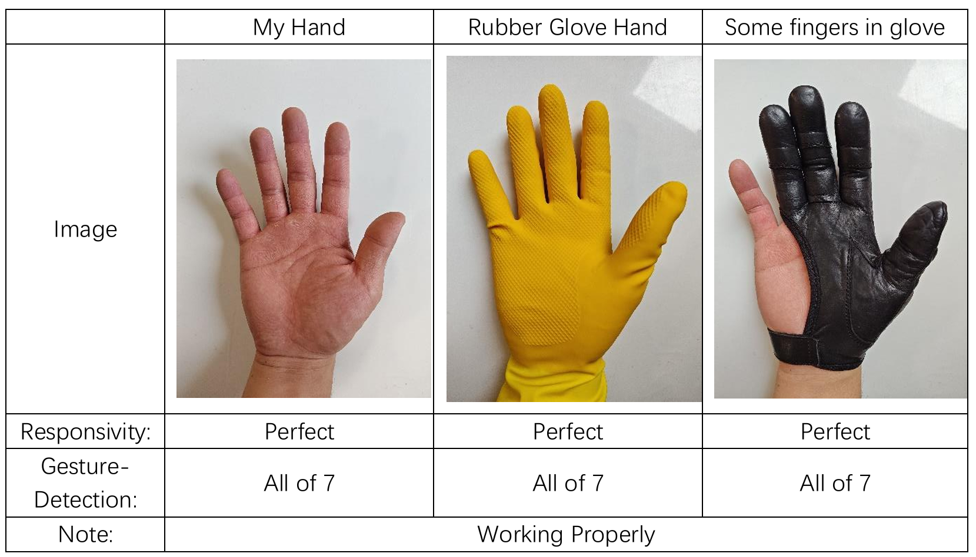
Experiment and Analysis
Exploring the impact on hand tracking

Slide 18
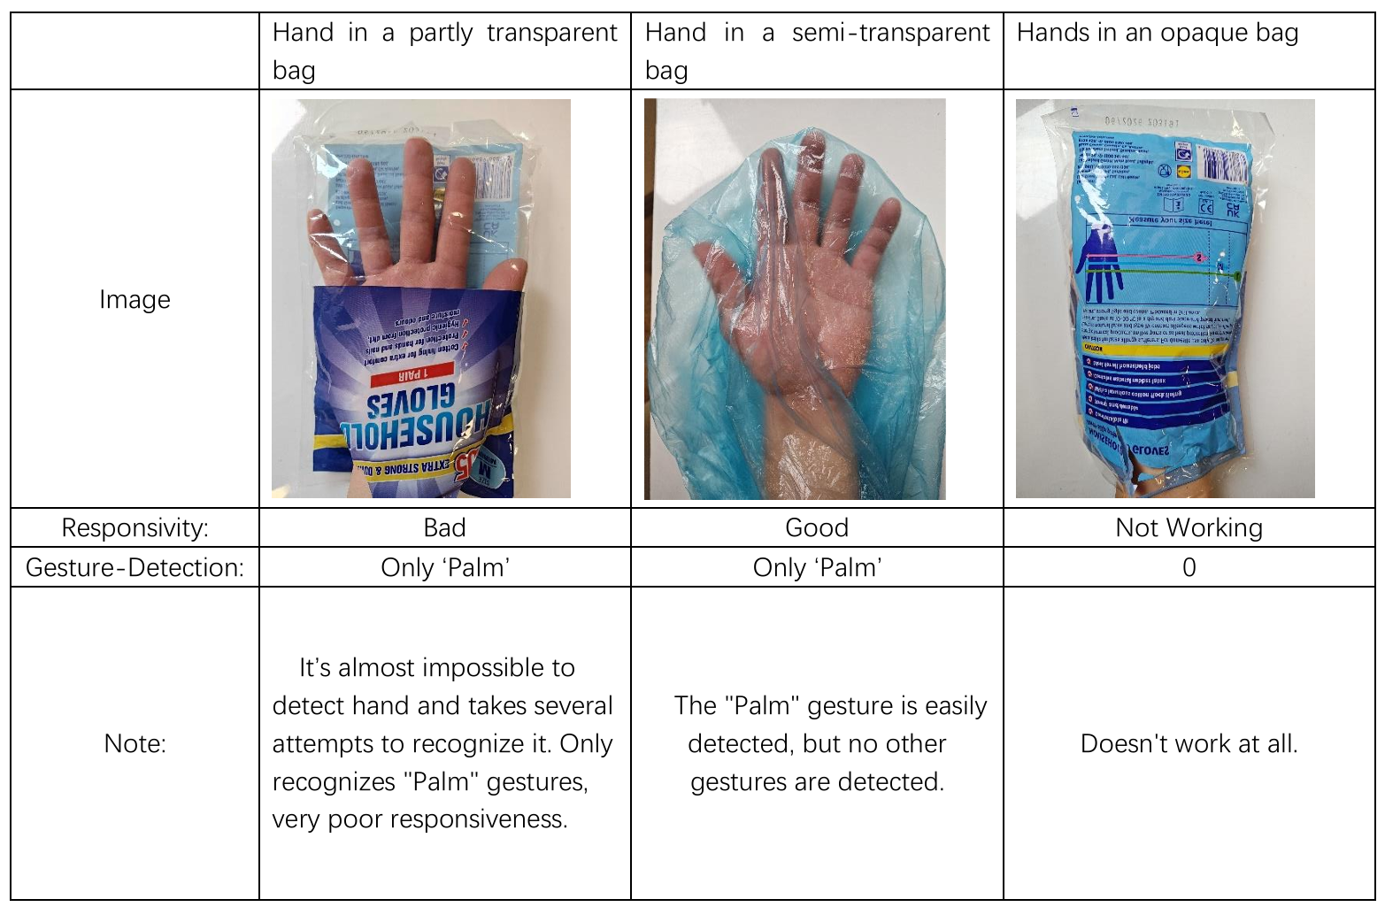
Experiment and Analysis
Exploring the impact on hand tracking

Slide 19
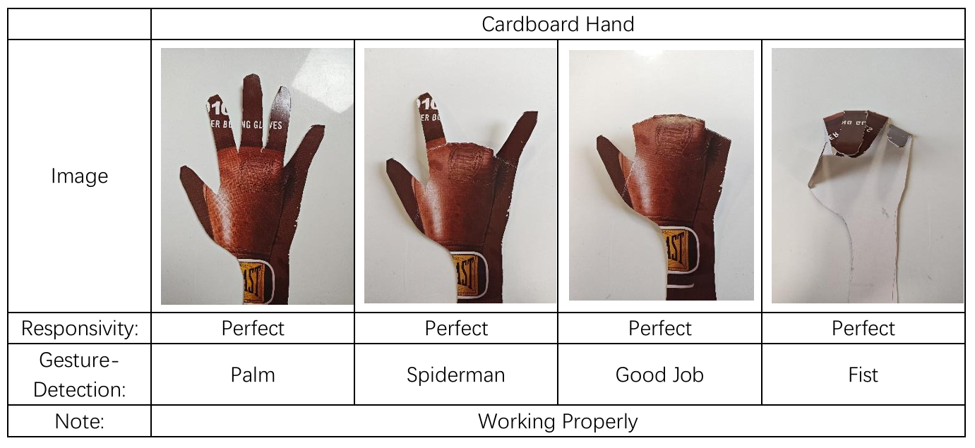
Experiment and Analysis
Exploring the impact on hand tracking

Slide 20
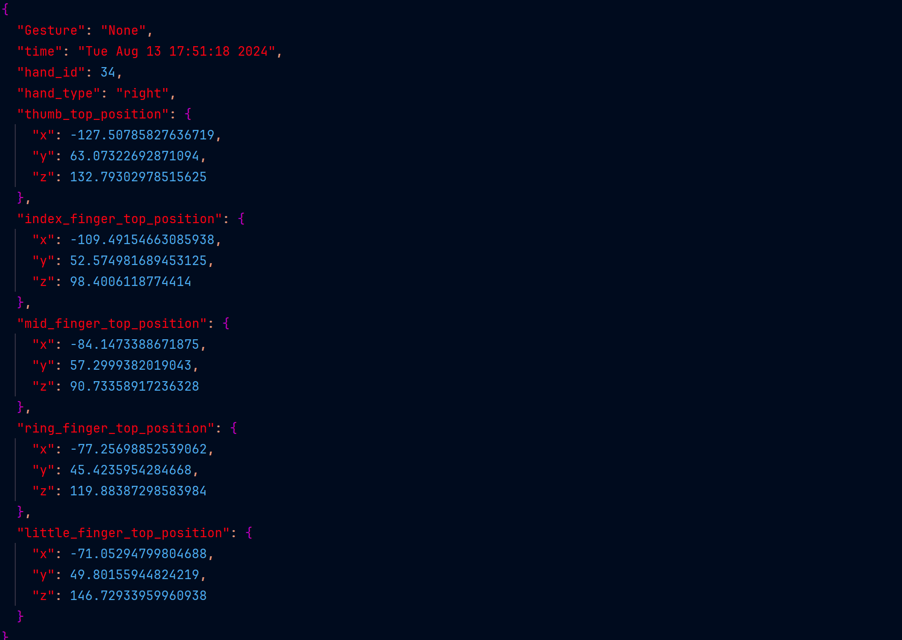
Experiment and Analysis
Data recorded as a time series
"None" means that the detected gesture is not one of the 7 gestures.

Slide 21
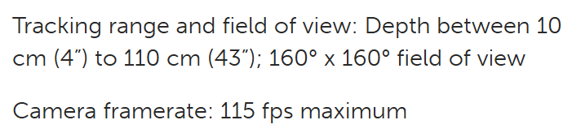
Experiment and Analysis
Analysis
Leap Motion Controller uses infrared optical sensors to detect hand movement. And it will detect any hand-shaped target and is not affected by color, whether organic or inorganic. Masking the detected target can significantly affect detection accuracy and response speed, and if a transparent mask is used, it depends on the degree of transparency of the mask.
The tracking range and field are as below:

Slide 22

05
PART Five
Project Demonstration
Shihao Zhou ID: 230594553

Slide 23
The Ending
Thank you for watching.
With thanks for my supervisor,
Mr. Matthew Dyson's guidance and support.
Welcome to the question.

